Slide 1





Nanowires and Heterostructures
Michael Christiansen
Mentor: Dr. Jeff Drucker
Statewide Space Grant Symposium
17 April 2010
Special thanks to: Jeff Drucker, Nick Jungwirth, Sutharsan Ketharanathan, Prashanth Madras, and Eric Dailey

Slide 2
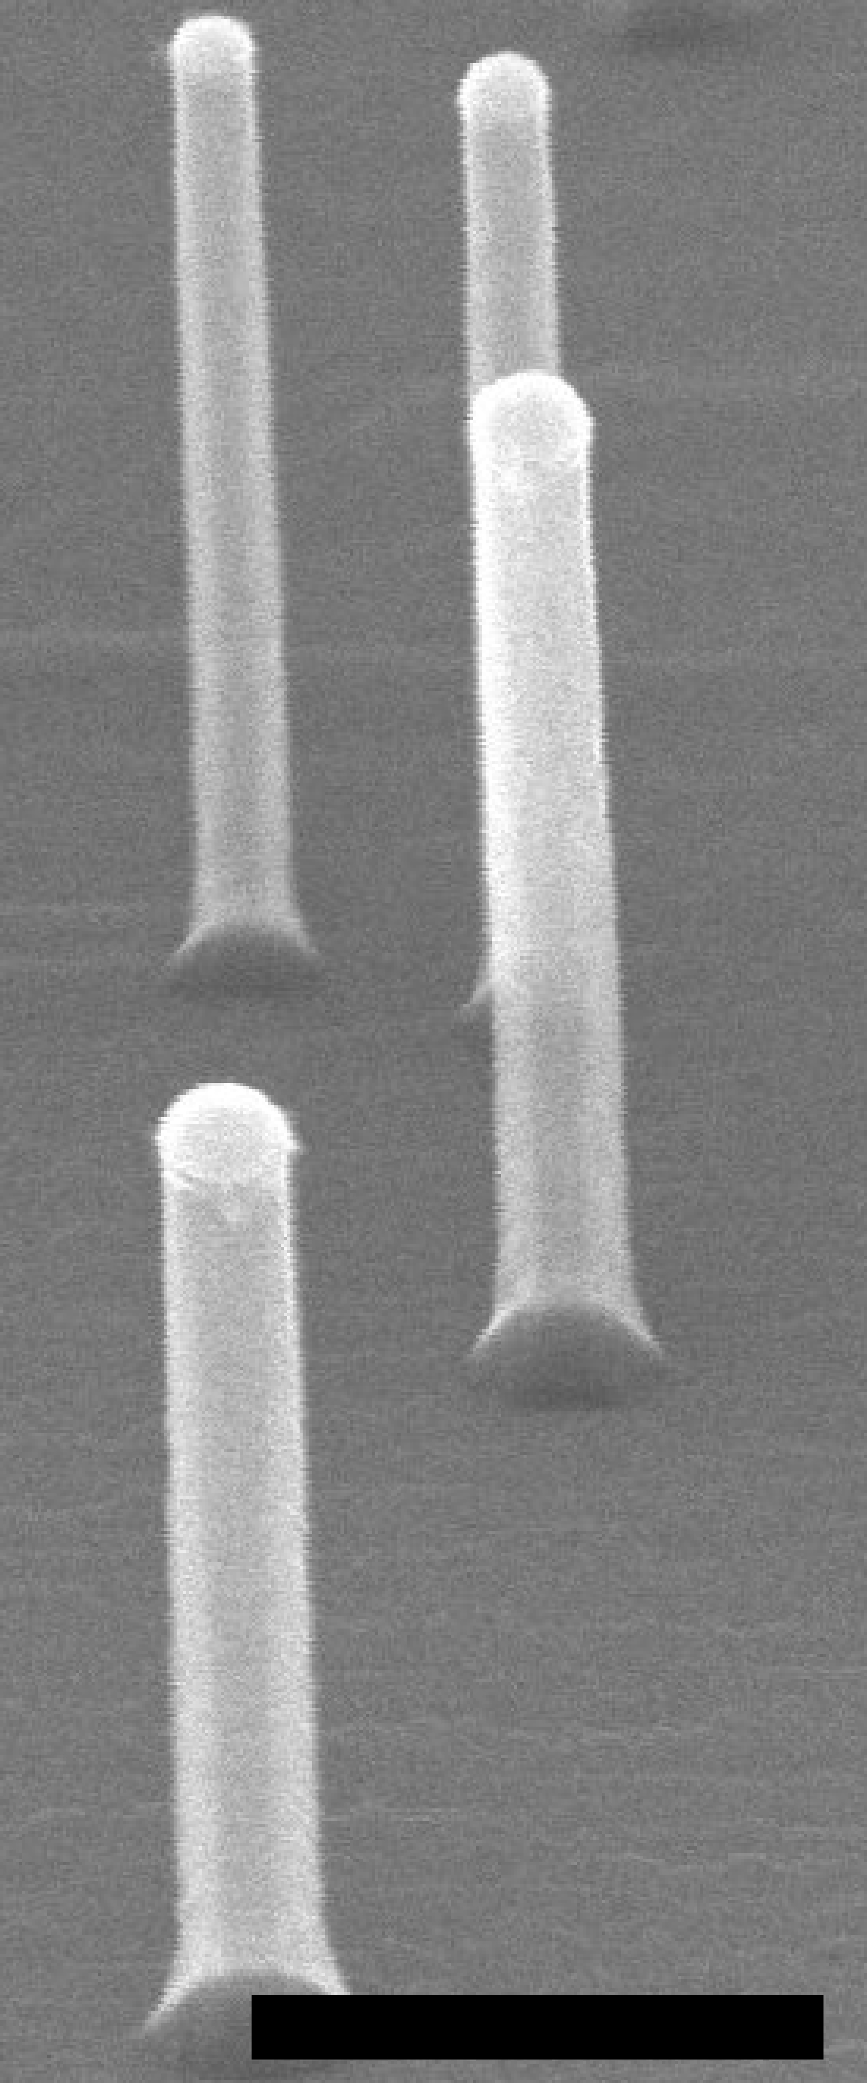
Nanowires
“One dimensional” nanostructures, approximately cylindrical
Length is generally about 1𝜇m and diameter is 10 to 100 nm
Made of the Group IV elements silicon and germanium
May contribute to applications such as photovoltaics, thermoelectrics, and nanoelectronics
500nm
(SEM, courtesy of Jeff Drucker)

Slide 3
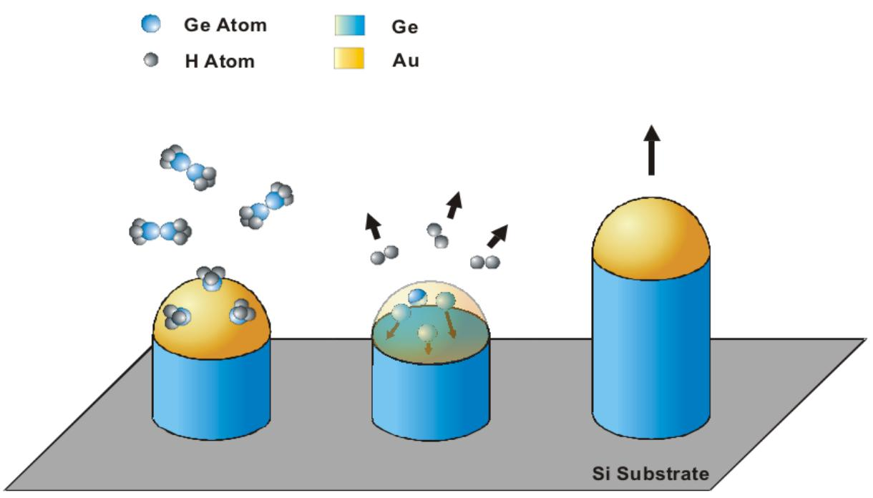
Vapor-Liquid-Solid Growth Process
Thermal deposition of metal catalyst (e.g. gold), forming droplets that are a liquid mixture of silicon and gold
Addition of silicon or germanium to the droplet (via reaction of Si₂H₆ or Ge₂H₆) results in crystal growth outward from the substrate
(Diagram courtesy of Jeff Drucker)
(Graph from Scientific Thermodata Group Europe, www.sgte.org)

Slide 4
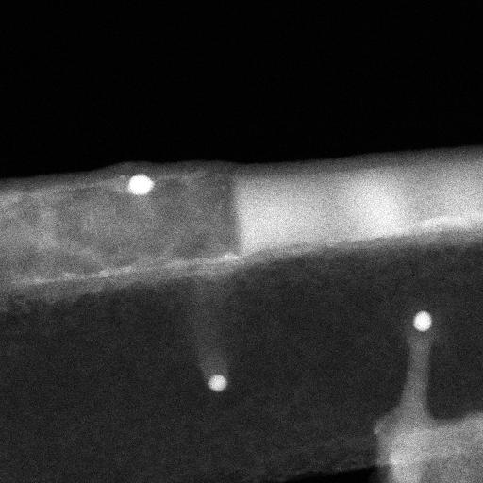
Axial Heterostructures:
Our Project
(TEM, courtesy of Jeff Drucker)
Grown by switching between adding silicon and adding germanium, resulting in alternating segments
Two main challenges:
An atomically abrupt transition between silicon and germanium is desirable.
Sidewall deposition needs to be minimized.
Our project: to investigate thermal deposition of alternative metal catalysts

Slide 5
Gold vs. Indium
(Graphs from Scientific Thermodata Group Europe, www.sgte.org)

Slide 6
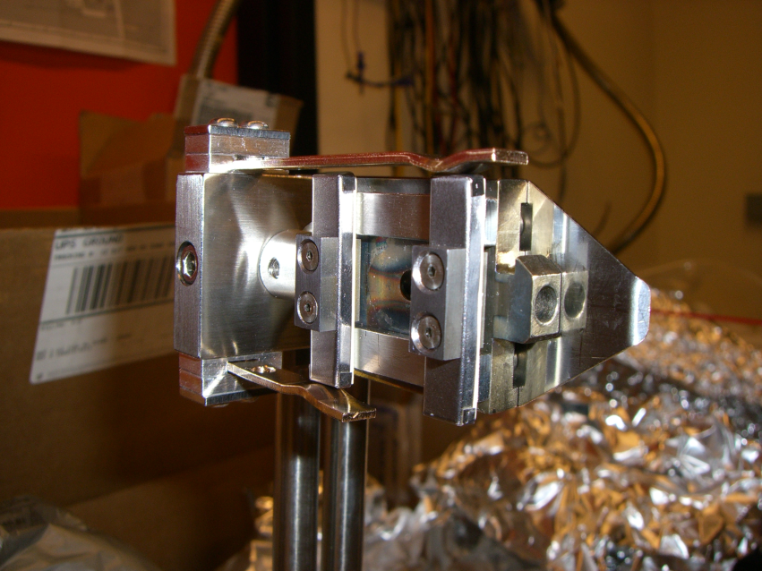
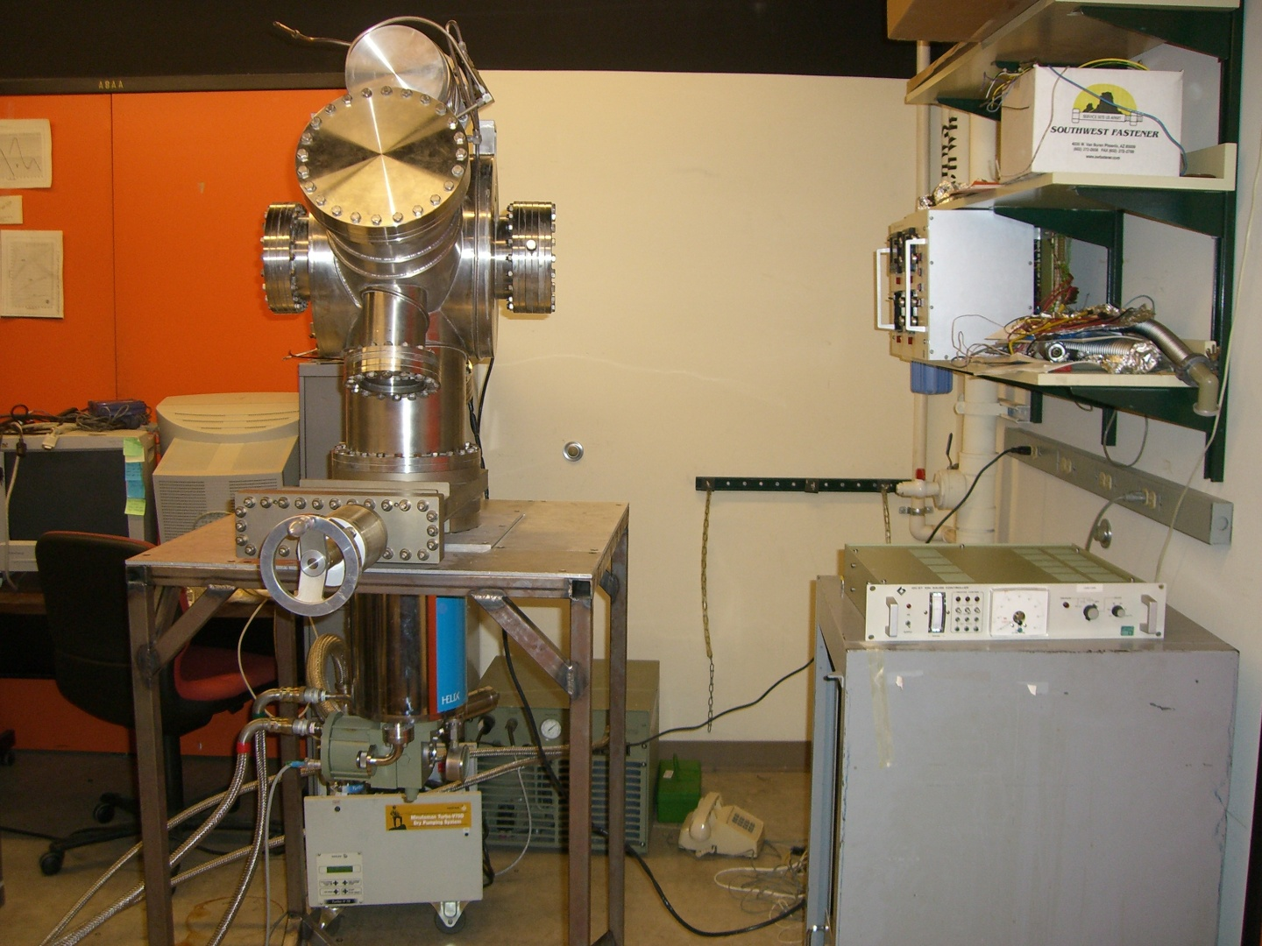
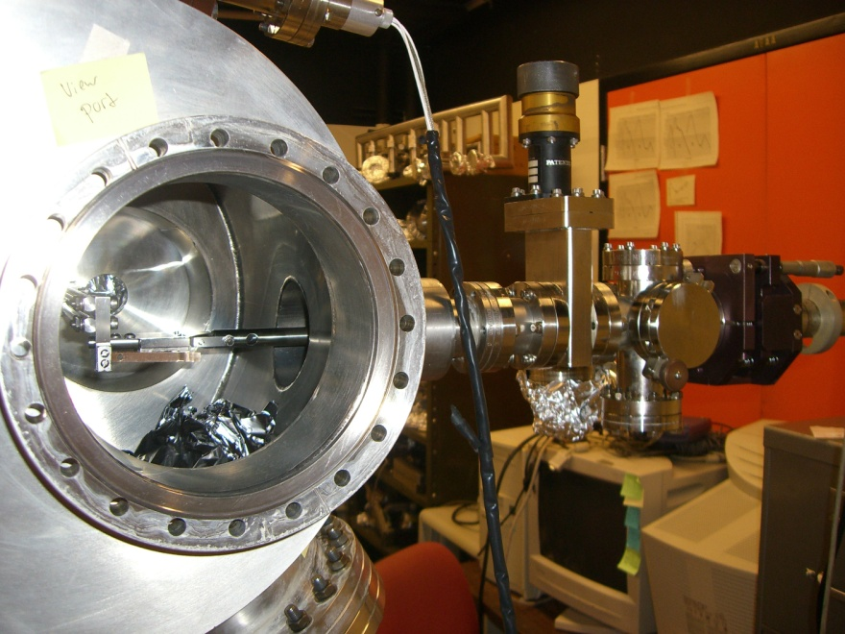
Progress
Construction of ultrahigh vacuum chamber (target pressure 10⁻⁹ Torr, or 1/10¹² atm)
Transfer mechanism for samples
Calibration of In evaporation source
Characterization of substrate heating

Slide 7
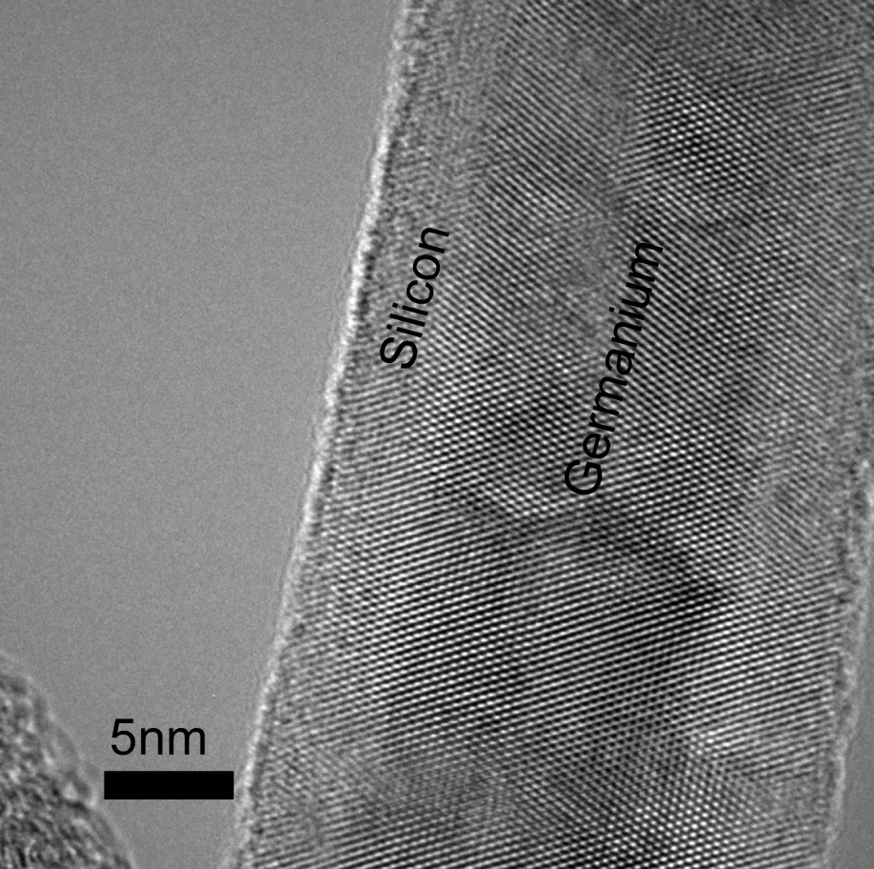
Thanks for listening.
Questions?
(TEMs, courtesy of Prashanth Madras)

